Slide 1
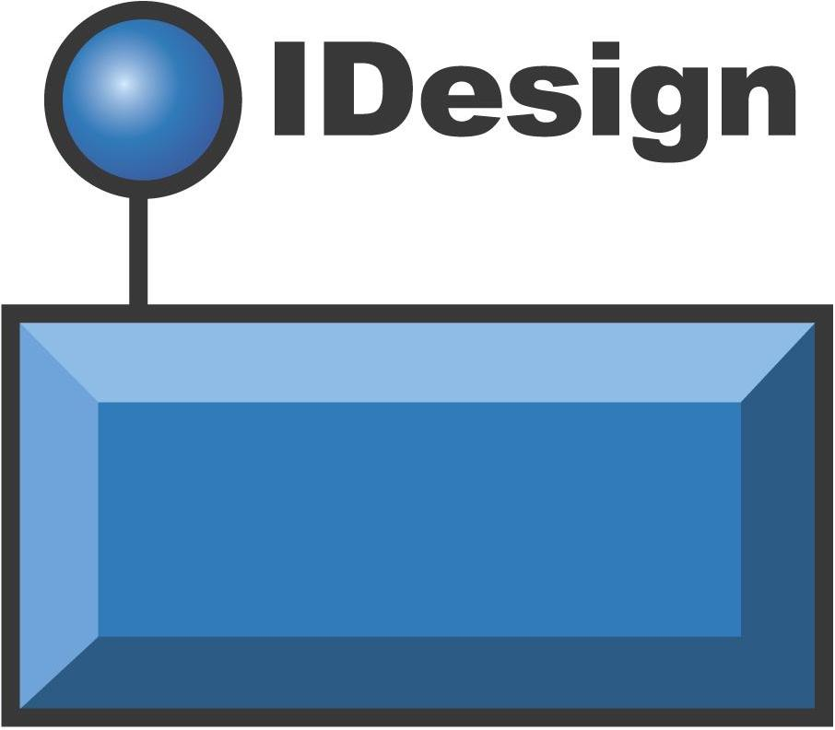

Slide 2
Custom design for:
Panayiotou Inc.

Slide 3
Electronic Pazari Architecture Iteration 3

Slide 4
Notes
Architecture is based on IDesign Alumni Forum thread:
Virtual Method – Trading System
See relevant post attachments by Michael Panayiotou for business rationale, requirements, trader workflow and core use case details.

Slide 5
Key
[] Optional or workflow specific step
{} Notes
* Sub-use case
Synchronous
Async Queued Persistent
Async/Queued Transient

Slide 6
Common Interview Questions
What is the business of the system?
What are the integration and interoperability requirements?
What is the timeline for the deployment?
Resale opportunity?
Why/ why not off the shelve?
What is the number one pain point?
How would different users use this system?
What are the roles the users play?
Performance, throughput, scalability requirements?
How would the introduction of the system change the business?

Slide 7
Mission Statement
Create a platform to enable the efficient, flexible trade of current and future commodities.

Slide 8
Objectives
Support the easy addition of new commodity types.
Support the easy addition of new order types.
Decouple admin tasks, trading, analysis, matching and feeds as much as possible.
Support very high throughput and flexible scaling options across each major subsystem.
Consider cost effectiveness
Support the ‘multiplicity of clients’
Support cloud migration strategies

Slide 9
Observations
Non-volatile:
Trader, Order, Rating, Commodity, Feed, Notification Mgmt.
Volatile
Trading, Matching, Order type extensibility, Analytics, Feeds, UI workflows
System extensibility
Trader Mgmt., Order Mgmt., Ratings and Notification Mgmt. are administrative tasks.
Queuing is the key to throughput and scalability.
The Pub/Sub Service is the cornerstone of the system
The Pub/Sub Service must also be publicly accessible to publish live feeds and notifications
Pub/Sub as Message Bus more applicable
Orders and Trades are historical facts
Analytics data is reconstituted for timeliness, but is assumed stale w/ a freshness date provided

Slide 10
‘Classic Enterprise’ Operational Concepts (Iteration 1)
Separate volatility concerns to facilitate flexible scaling options and improve business agility.
Workflows are extensible, managed through the admin portion of the system and can even be maintained externally.
Clients are expected to be different form factors and succinct workflows are crafted for each.
Caching is used to improve responsiveness of certain key subsystems.
Queuing between subsystems (i.e. Managers) ensures lossless data flow.
Feeds to clients are transient, as stale feed data has little value.
Integrate public feeds into the Feeds subsystem to reduce complexity and simplify administration.

Slide 11
‘Agile’ Enterprise Operational Concepts (Iteration 2)
The partitioning and deployment of the well-factored Workflow Manager contracts into separate subsystems empowers business agility.
The partitioning of the Data Tier further supports subsystem autonomy.

Slide 12
Contemporary Enterprise Operational Concepts (Iteration 3)
The Message Bus is the fundamental extensibility point of the system, allowing the interaction of any number of subsystems to be orchestrated and organized into arbitrarily complex patterns.
Messages now become the application, carrying relevant contextual information with them as they move through a dynamic environment.
The Message Bus is publicly available to allow direct client interaction modes.

Slide 13
Core Use Cases
Submit new order
Subscribe to feed, notification
Add commodity
View trade analysis
Submit trader rating
Receive live feed

Slide 14
Architecture Static Aspect

Slide 15
Presentation
Trader
Client
Public
Client
iFX
Proxy
Bases
Business Logic
Host
WinService
Trading
Workflow
Manager
Market
Workflow
Manager
Feed
Manager
Admin
Workflow
Manager
Analytics
Manager
Cache
Validation
Engine
Matching
Engine
Filter
Engine
Transform
Engine
Logger
Timer
Resource Access
Trading
Data Access
Admin
Data Access
Historical
Data Access
Analytics
Data Access
News
API Access
Pricing
API Access
DAL
Message
Bus
Workflow
Data Access
Resource
Trading
Database
Admin
Database
Historical
Database
Analytics
Database
News
API
Pricing
API
Workflow
Database
Iteration 3 - Static Tier View

Slide 16
Architecture Dynamic Aspect

Slide 17
Message Bus
Interaction Pattern
Trader
Public
Admin
Mobile
Message
Bus
Message
Bus
Message
Bus
Message
Bus
Message
Bus
. . .
Message
Bus
Manager
Manager
Engine
Engine
Data Access
API Access
Data Access
API Access
Database
API
Database
API

Slide 18
Manage
Orders
Trader
Message
Bus
Message
Bus
Message
Bus
Workflows
Cache
Trading
Workflow
Manager
Market
Workflow
Manager
Validation
Engine
Trading
Data Access
Trading
Database

Slide 19
Trade
Message
Bus
Message
Bus
Market
Workflow
Manager
Analytics
Manager
Matching
Engine
Pending Orders, Trades
Cache

Slide 20
Process Analytics
Message
Bus
Message
Bus
Analytics
Manager
Feed
Manager
Transform
Engine
Analytics
Data Access
Historical
Data Access
Analytics
Database
Historical
Database

Slide 21
Manage
Commodities
Admin
Message
Bus
Message
Bus
Message
Bus
Workflows
Cache
Admin
Workflow
Manager
Analytics
Manager
Validation
Engine
Trading
Data Access
Trading
Database

Slide 22
Manage
Traders, Ratings, Feeds, Notifications
Trader
Message
Bus
Message
Bus
Workflows
Cache
Admin
Workflow
Manager
Validation
Engine
Admin
Data Access
Admin
Database

Slide 23
Manage
Workflows
Admin
Message
Bus
Message
Bus
Workflows
Cache
Admin
Workflow
Manager
Validation
Engine
Workflow
Data Access
Workflow
Database

Slide 24
Subscribe
Public Feeds
Client
Message
Bus
Message
Bus
Feed
Manager
Filter setup
Cache
Validation
Engine
News
API Access
Pricing
API Access
…
News
API
Pricing
API
…

Slide 25
Produce
Public Feeds
Client
Message
Bus
Message
Bus
Feed
Manager
Pub/Sub
Service
<Public>
API
Filter setup
Cache
Filter
Engine

Slide 26
Assemblies

Slide 27
iFX Server-side Assemblies(DLLs)
Trading Workflow
Manager Assembly(DLL)
Feed
Manager Assembly(DLL)
Admin Workflow
Manager Assembly(DLL)
Market Workflow
Manager Assembly(DLL)
Analytics
Manager Assembly(DLL)
ServiceModelEx Assembly(DLL)
Validation
Engine Assembly(DLL)
Filter
Engine Assembly(DLL)
Matching
Engine Assembly(DLL)
Transform
Engine Assembly(DLL)
DAL Assembly(DLL)
Trading Data Access Assembly(DLL)
Admin Data Access Assembly(DLL)
Analytics Data Access Assembly(DLL)
Historical Data Access Assembly(DLL)
Workflow Data Access Assembly(DLL)
Cache
Assemblies(DLLs)
News API Access Assembly(DLL)
Pricing API Access Assembly(DLL)
<…> API Access Assembly(DLL)
Pub/Sub Assembly(DLL)
Message Bus Assembly(DLL)
iFX Common Assemblies(DLLs)
Assembly Allocations

Slide 28
Services

Slide 29
<All>
Manager Assembly(DLL)
Message Bus Assembly(DLL)
Pub/Sub Assembly(DLL)
Public WCF Services

Slide 30
<All>
Engine Assembly(DLL)
<All> Data Access Assembly(DLL)
<All> API Access Assembly(DLL)
InProc WCF Services

Slide 31
Trading Workflow
Manager Assembly(DLL)
Validation
Engine Assembly(DLL)
Trading Data Access Assembly(DLL)
Logical Service - Trading

Slide 32
Admin Workflow
Manager Assembly(DLL)
Validation
Engine Assembly(DLL)
Admin Data Access Assembly(DLL)
Workflow Data Access Assembly(DLL)
Logical Service - Administration

Slide 33
Market Workflow
Manager Assembly(DLL)
Matching
Engine Assembly(DLL)
Logical Service - Trade

Slide 34
Analytics
Manager Assembly(DLL)
Transform
Engine Assembly(DLL)
Analytics Data Access Assembly(DLL)
Historical Data Access Assembly(DLL)
Logical Service - Analytics

Slide 35
Feed
Manager Assembly(DLL)
Validation
Engine Assembly(DLL)
Filter
Engine Assembly(DLL)
Analytics Data Access Assembly(DLL)
News API Access Assembly(DLL)
Historical Data Access Assembly(DLL)
Pricing API Access Assembly(DLL)
<…> API Access Assembly(DLL)
Logical Service - Feeds

Slide 36
Processes

Slide 37
Client Application(EXE)
Contracts
Assembly(DLL)
iFX Client-side Assemblies(DLLs)
iFX Common Assemblies(DLLs)
Message Bus Assemblies(DLLs)
Process Boundary - Client (EXE)

Slide 38
Host
IIS 7.5
Client ASP.NET
iFX Client-side Assemblies(DLLs)
Contracts
Assembly(DLL)
iFX Common Assemblies(DLLs)
Message Bus Assemblies(DLLs)
(W3WP)
Process Boundary - Client (ASP.NET)

Slide 39
Client Browser App
Host
IIS 7.5
Contracts
Assembly(DLL)
iFX Client-side Assemblies(DLLs)
Web API
Web API
iFX Common Assemblies(DLLs)
WebSockets
WebSockets
Message Bus Assemblies(DLLs)
(W3WP)
Process Boundary - Client (Browser App)

Slide 40
Client Native App
Host
IIS 7.5
Contracts
Assembly(DLL)
iFX Client-side Assemblies(DLLs)
Web API
Web API
iFX Common Assemblies(DLLs)
WebSockets
WebSockets
Message Bus Assemblies(DLLs)
(W3WP)
Process Boundary - Client (Native App)

Slide 41
Host
WAS
IIS 7.5
Contracts
Assemblies(DLL)
Each Logical Service
can be hosted
separately or together.
In the case of hosting
within WAS, to host
separately, each is
provided it’s own
App Pool…
iFX Server-side Assemblies(DLLs)
ServiceModelEx Assembly(DLL)
DAL Assembly(DLL)
Cache
Assemblies(DLLs)
Pub/Sub Assembly(DLL)
Message Bus Assembly(DLL)
iFX Common Assemblies(DLLs)
Process Boundary - Application Tier

Slide 42
Host
Win Service
Application(EXE)
Contracts
Assembly(DLL)
Each Logical Service
can be hosted
separately or together.
Managers should be
automatically hosted
through custom
ServiceHosts and
Host helper iFX…
iFX Server-side Assemblies(DLLs)
ServiceModelEx Assembly(DLL)
DAL Assembly(DLL)
Cache
Assemblies(DLLs)
Pub/Sub Assembly(DLL)
Message Bus Assembly(DLL)
iFX Common Assemblies(DLLs)
Process Boundary - Self Hosted Application Tier

Slide 43
Trading
Database
Workflow
Database
Admin
Database
Analytics
Database
Historical
Database
Process Boundary - Data Tier

Slide 44
Identities

Slide 45
Client
Message
Bus
Message
Bus
. . .
Message
Bus
Manager
Manager
Engine
Engine
Data Access
API Access
Data Access
API Access
Database
API
Database
API
Connectivity Identity Pattern

Slide 46
Message
Bus
Message
Bus
. . .
Message
Bus
Client
Manager
Manager
Engine
Engine
Data Access
API Access
Data Access
API Access
Database
API
Database
API
Application Identity Pattern

Slide 47
Authentication

Slide 48
Client
Message
Bus
Message
Bus
. . .
Message
Bus
Manager
Manager
Engine
Engine
Data Access
API Access
Data Access
API Access
Database
API
Database
API
Authentication Pattern

Slide 49
Authorization

Slide 50
Client
Message
Bus
Message
Bus
. . .
Message
Bus
Manager
Manager
Engine
Engine
Data Access
API Access
Data Access
API Access
Database
API
Database
API
Authorization Pattern

Slide 51
Transactions

Slide 52
Client
Message
Bus
Message
Bus
. . .
Message
Bus
Manager
Manager
Engine
Engine
Data Access
API Access
Data Access
API Access
Database
API
Database
API
Transactional Pattern

Slide 53
Logical Threads

Slide 54
Client
Message
Bus
Message
Bus
. . .
Message
Bus
Manager
Manager
Engine
Engine
Data Access
API Access
Data Access
API Access
Database
API
Database
API
Logical Thread Pattern

Slide 55
API Access

Slide 56
Internet
3rd Party
Client
Native
Client
Browser
Client
DMZ
Public
API
Web
API
LAN
Internal
Client
Manager
Engine
Data Access
Client Access Zones – Public+Private+Internal

Slide 57
Internet
3rd Party
Client
Native
Client
Browser
Client
DMZ
Public
API
Web
API
Synchronizing Compensation
LAN
Message
Bus
Message
Bus
Internal
Client
Message
Bus
Message
Bus
Manager
Engine
Data Access
Client Access Zones – Public+Private+Internal

Slide 58
Internet
3rd Party
Client
Native
Client
Browser
Client
DMZ
Public
API
Web
API
WebSockets API, not WCF
LAN
Message
Bus
Message
Bus
Internal
Client
Message
Bus
Message
Bus
Manager
Engine
Data Access
Client Access Zones – Public+Private+Internal

